Slide 1
SMART CITY TRAFFIC ANALYSIS
Optimizing Urban Traffic Flow Through Data-Driven Insights
Name : Pankaj
UID : 25MCD10027

Slide 2
Project Overview
Objective:
Optimize urban traffic flow, reduce congestion, improve road safety, and enhance public transportation efficiency.
Approach:
Collected real/simulated traffic datasets
Stored and queried data using MySQL
Analyzed patterns and trends in Excel
Visualized insights through an Interactive Power BI Dashboard

Slide 3
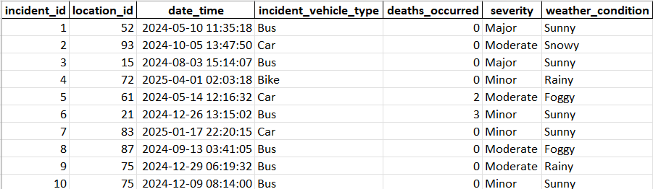
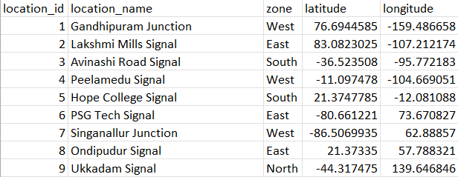
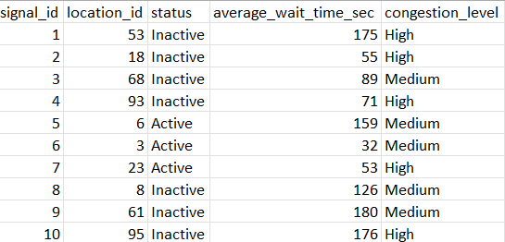
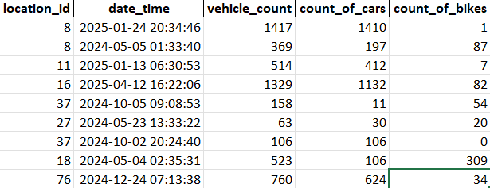
DATABASE AND DATA MODEL
Database: coimbatore_city_traffic
Key Tables:
traffic: traffic volume, weather, average speed, vehicle counts
congestion: congestion levels, traffic signal status
accident: accidents, deaths, timestamps
location: zone, location names

Slide 4
Key SQL Queries
Retrieve Signal Details:
SELECT signal_id, location_id, status
FROM congestion;
Count of Signals Grouped by Status:
SELECT status, COUNT(*) AS signal_count
FROM congestion
GROUP BY status;
Top 5 Locations with Highest Number of Accidents:
SELECT l.location_name, COUNT(a.incident_id) AS total_accidents
FROM accident a
JOIN location l ON a.location_id = l.location_id
GROUP BY l.location_name
ORDER BY total_accidents DESCLIMIT 5;
Location-Wise Deaths Due to Accidents:
SELECT l.location_name, SUM(a.deaths_occurred) AS total_deaths
FROM accident a
JOIN location l ON a.location_id = l.location_id
GROUP BY l.location_name
ORDER BY total_deaths DESC;
Average Congestion Level by Zone:
SELECT l.zone, AVG( CASE WHEN c.congestion_level = 'High' THEN 3 WHEN c.congestion_level = 'Medium' THEN 2 WHEN c.congestion_level = 'Low' THEN 1 END) AS avg_congestion_score
FROM congestion c
JOIN location l ON c.location_id = l.location_id
GROUP BY l.zone
ORDER BY avg_congestion_score DESC;

Slide 5
Accidents Distribution by Time of Day:
SELECT CASE WHEN HOUR(a.date_time) BETWEEN 6 AND 12 THEN 'Morning' WHEN HOUR(a.date_time) BETWEEN 12 AND 17 THEN 'Afternoon' WHEN HOUR(a.date_time) BETWEEN 17 AND 21 THEN 'Evening' ELSE 'Night' END AS time_of_day,
COUNT(a.incident_id) AS accident_count
FROM accident a
GROUP BY time_of_day
ORDER BY accident_count DESC;
Impact of Temperature on Average Speed:
SELECT CASE WHEN temperature_celsius < 20 THEN 'Cold' WHEN temperature_celsius BETWEEN 20 AND 30 THEN 'Moderate' ELSE 'Hot' END AS temp_category, AVG(average_speed_kmph) AS avg_speed
FROM traffic
GROUP BY temp_category
ORDER BY avg_speed DESC;

Slide 6
Dashboard Insights - Accident Analysis
Top 5 Locations with Highest Accidents: Critical for safety interventions
Deaths by Location: Prioritizing emergency services allocation
Accidents by Time of Day:
Evening and Night times showed higher accident rates
Can optimize patrol schedules

Slide 7
Dashboard Insights - Congestion and Traffic Flow
Average Congestion by Zone: Identified zones requiring better traffic management
Traffic Signal Status: Monitored real-time status (active, inactive, faulty)
Average Vehicle Speed per Zone: Helped pinpoint slow-moving traffic areas

Slide 8
Dashboard Insights - Environmental Impact
Weather Impact:
Heavy rain and fog significantly reduced traffic volume.
Temperature Impact on Speed:
Higher temperatures saw reduced average speeds.
Vehicle Type Distribution:
Cars dominated traffic followed by bikes and buses.

Slide 9
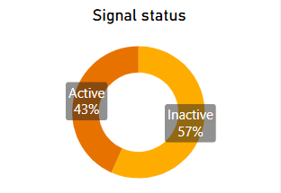
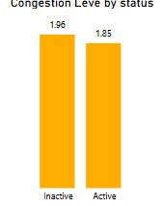
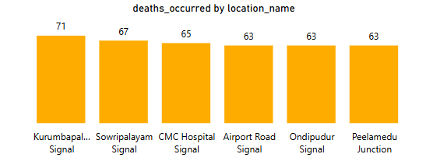
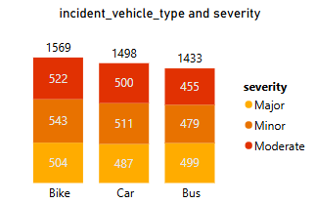
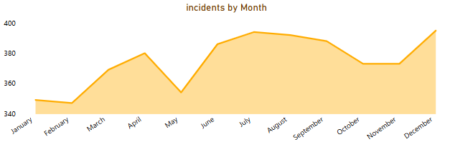
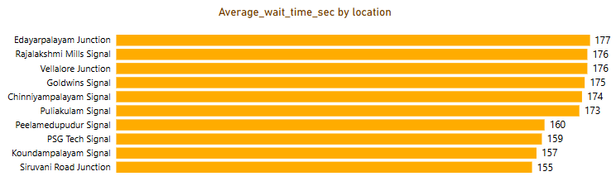
Power BI Dashboard Screenshots

Slide 10
Conclusion & Future Work
Conclusion: Data-driven analysis enabled proactive traffic management and safety planning.
Future Work:
Incorporate live IoT traffic feeds
Predictive modeling for congestion forecasting
Real-time accident alerts

